Slide 1
Unit 3

Slide 2
Academic Institutions Involved
University of Madras
Lovely Professional University
Pondicherry University
Karunya Institute of Technology
Sage University
University of Lucknow
Guru Nanak University, Hyderabad,
And many other institutes.
National Forensic Sciences University.
Delhi University
Amity University
Banaras Hindu University
Bharathiyar University, Coimbatore
Punjab University
Jain University
Chandigarh University

Slide 3
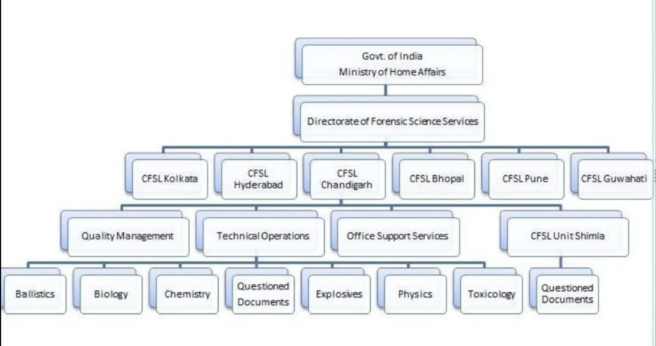
Organizational Set Up of the FSLs:

Slide 4
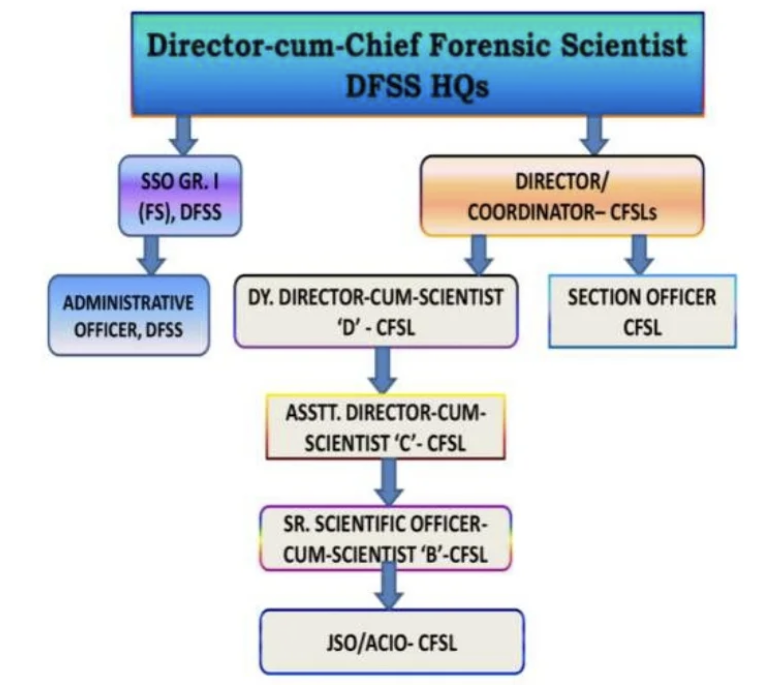
Hierarchical Set up of the Central FSLs:
Director
Joint Director
Additional/Deputy Director
Assistant Director (For each Division)
Senior Scientific Officer
Junior Scientific Officer
Senior Scientific Assistant
Junior Scientific Assistant
Lab Assistant
Lab Attendant
Receptionist, Sweeper, Peon, etc.

Slide 5
Government Examiners of QD
The British Govt. of Bengal created the post of Govt Handwriting Expert of Bengal and appointed Mr. CR Hardless, to this designation in 1904.
The whole setup was shifted to Shimla in the year 1906 and placed under the control of the Director, CID.
MR. CR Hardless was appointed to the freshly established post of Handwriting Expert for the Govt of India.
Mr. S. N. Sen, the first Indian took over the post in 1949.
Similar types of laboratories (GEQD) were also set up at Calcutta and Hyderabad.
Presently GEQD Kolkata, Shimla, and Hyderabad have been merged with CFSL, Kolkata, Chandigarh, and Hyderabad, respectively.

Slide 6
Government Examiners of QD
Keeping the increasing number of cases in consideration, related to QD, Forensic Document Examination, a similar type of Govt Examiner of QD Laboratories (GEQD) was set up at Calcutta in 1964 and Hyderabad in 1969.
Calcutta was supposed to sever the central and Eastern states of the country, whereas Hyderabad is supposed to cater to the Southern and Western states of the country.

Slide 7
Fingerprint Bureau
William Herschel- Permanency of Fingerprints
In 1891- Edward Richard Henry was appointed as the inspector General of Bengal Police and made the thumb impressions compulsory in the record slips along with anthropometric data, to avoid mistakes in the identification.
Fingerprint Bureau- 1897 (Calcutta)
India becomes the first country in the world to start the personnel identification solely on the basis of fingerprints.

Slide 8
Central Fingerprint Bureau
On the recommendations of the Royal Police Commission of 1902-1903, the first Central Fingerprint Bureau (CFPB) in India was established in 1905 at Shimla.
It, however, suffered a setback and was abolished in 1922 as a result of retrenchment proposals of the Inchcape Committee. On the recommendations of the committee, the CFPB restarted functioning in 1955 in Delhi under the administrative control of the Intelligence Bureau (IB).
The major role envisaged for CFPB was to coordinate the activities of the State Fingerprint Bureau in tracing/locating criminals.
In August 1956, the CFPB was shifted to Calcutta and remained under the administrative control of IB.
September 1973, it was transferred to the Central Bureau of Investigation.
July 1986, the administrative control of the CFPB was transferred to the National Crime Records Bureau (NCRB) and was again shifted to New Delhi.

Slide 9
National Crime Records Bureau
NCRB was set up in 1986 to function as a repository of information on crime and criminals so as to assist the investigators in linking crime to the perpetrators based on the recommendations of the Tandon Committee, National Police Commission (1977-1981), and the MHA’s Taskforce (1985).
Subsequently, NCRB was entrusted with the responsibility for monitoring, coordinating, and implementing the Crime and Criminal Tracking Network & Systems (CCTNS) project in the year 2009. The project has connected 15000+ police stations and 6000 higher offices of police in the country.
The Bureau has also been entrusted to maintain National Database.
NCRB also compiles and publishes National Crime Statistics i.e. Crime in India, Accidental Deaths & Suicides, and also Prison Statistics.
NCRB also assists various States in capacity building in the area of Information Technology, CCTNS, Finger Prints, Network Security, and Digital Forensics through its training centers in Delhi, and Kolkata. It also assists four Regional Police Computer Training Centres (RPCTC) at Hyderabad, Gandhi Nagar, Lucknow, and Kolkata.

Slide 10
Police and Detective Training Schools
Central Detective Training School at Calcutta:
CDTS, Calcutta, a premier detective training school in India, was established in the year 1956 and was co-located with CFPB, Calcutta.
The aim of establishing such a school was to impart training in the scientific investigation of crimes like drug abuse, terrorism, explosion, crime against women, investigation of road accidents, and enforcement of traffic laws, etc. to the trainee from police, Armed forces, and Paramilitary organizations.
Police officers from neighboring countries like Nepal, Sri Lanka, etc. were also able to get training under Colombo Plan.
CDTS at Hyderabad and Chandigarh:
The Central Detective Training School, Hyderabad was established in 1964, on the pattern of the CDTS, Calcutta, followed by another one at Chandigarh, during the period of 1973.
Their chief objective was to train effective police personnel in up-to-date scientific techniques of crime investigation, with ab opinion to expand their professional standard and efficiency.

Slide 11
National Investigation Agency (NIA)
Over the past several years, India has been the victim of large scale terrorism sponsored from across the borders. There have been innumerable incidents of terrorist attacks, not only in the militancy and insurgency affected areas and areas affected by Left Wing Extremism, but also in the form of terrorist attacks and bomb blasts, etc., in various parts of the hinterland and major cities, etc.
A large number of such incidents are found to have complex inter-State and international linkages, and possible connection with other activities like the smuggling of arms and drugs, pushing in and circulation of fake Indian currency, infiltration from across the borders, etc. keeping all these in view, it was felt that there was a need for setting up of an Agency at the Central level for investigation of offences related to terrorism and certain other Acts, which have national ramifications

Slide 12
National Investigation Agency (NIA)
The Government after due consideration and examination of the issues involved proposed to enact legislation to make provisions for the establishment of a National Investigation Agency in a concurrent jurisdiction framework, with provisions for taking up specific cases under specific Acts for investigation.
Accordingly, the NIA Act was enacted on 31-12-08 and the National Investigation Agency (NIA) was born. At present, NIA is functioning as the Central Counter Terrorism Law Enforcement Agency in India.
NIA has registered and investigated 315 cases as of 05.02.2020. After the submission of charge sheets, 60 cases have been finally or partially decided in trial. Of these, 54 cases have ended in conviction giving NIA an enviable conviction percentage of 90%.

Slide 13
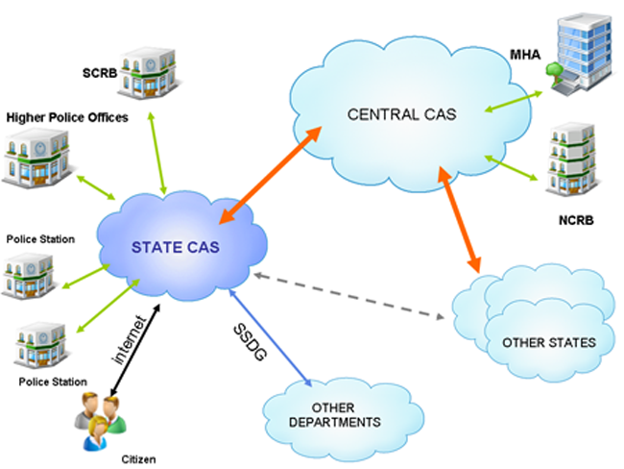
Crime and Criminal Tracking Network & Systems (CCNTS)
A planning scheme conceived in the light of the experience of a non-plan scheme namely – Common Integrated Police Application (CIPA).
CCTNS is a Mission Mode Project under the National e-Governance Plan (NeGP) of Govt. of India.
CCTNS aims at creating a comprehensive and integrated system for enhancing the efficiency and effectiveness of policing through adopting of principle of e-Governance and the creation of nationwide networking infrastructure for the evolution of an IT-enabled-state-of-the-art tracking system around the 'Investigation of crime and detection of criminals.

Slide 14
Crime and Criminal Tracking Network & Systems (CCNTS)
CCIS (Centralized Circular Information System) was primarily an initiative to create crime- and criminals-related database that can be used for crime monitoring by monitoring agencies such as the National Crime Records Bureau (NCRB), State Crime Records Bureaus (SCRBx), and District Crime Records Bureaus (DCRBx), and to facilitate statistical analysis of crime and criminals related information with the States and monitoring agencies.
Now, CCIS data is used for publishing online reports such as Missing person reports and is also used as the basis for online query facilities that are available through the NCRB website. In addition, it is also used by NCRB to publish an annual nationwide Crime Report. CCIS focuses exclusively on Crime and Criminals information and does not address the other aspects of Police functioning.

Slide 15
Bureau of Police Public Research & Development
The Bureau of Police Research & Development (BPR&D) was set up in 1970 to identify the needs and problems of the police in the country, undertake research projects and studies, and suggest modalities to overcome problems and challenges and meet the needs and requirements of the police.
It was also mandated to keep abreast of the latest developments in the fields of science and technology, both in India and abroad, with a view to promoting the use of appropriate technology in police work
Over the years, the BPR&D has also been entrusted with the responsibility of monitoring the training needs and quality of training in the States and Central Police Organisations, and providing assistance for the same, as also assisting the States in modernization of the State Police Forces and Correctional Administration.
In the process, the BPR&D has also been tasked to assist the Ministry of Home Affairs and the CPFs, etc., in the development of Standards, Quality Requirements (QRs), etc., with respect to various types of equipments and items pertaining to infrastructure.
More recently, the BPR&D has also been entrusted with the responsibility of anchoring and coordinating the work of the National Police Mission .

Slide 16
Directorate of Forensic Sciences
The Directorate of Forensic Science services (DFSS) was created in the year 2002 by Ministry of Home Affairs, Govt. of India, after the bifurcation from BPR&D, based on the recommendations of National Human Rights Commission and Padmanabhaiah Committee on Police Reforms.
Founder M S Rao.
It was headed by Director-cum-Chief Forensic Scientist. It has six Central Forensic Science Laboratories under its control located at Chandigarh, Kolkata, Hyderabad, Pune, Guwahati, and Bhopal.

Slide 17
Directorate of Forensic Sciences
DFSS Controls forensic science laboratories and GEQDs.
Roles:
Training for those involved in justice delivery.
Scientific aid.
Regulates the working and control of FSL and GEQDs.
Provides financial and technical support.
Promotes research and development in the field
To review the practices in the field- DFSS manual

Slide 18
Mobile Forensic Science Laboratories
Mobile Forensic Science Laboratories or Field Units of Forensic Sciences Laboratories have been established in certain states.
The staff of the Mobile FSLs assists the investigating Officers in assembling evidence after the scene of the crime.
Tamil Nadu- 36 (one for each district and Commissionerate)
Karnataka- 20 (one for each district and Commissionerate)
Andhra Pradesh- 24 (one for each district and Commissionerate
Orissa 15, Gujarat-34, Kerala- 17, Rajasthan- 34 and Punjab-03

Slide 19
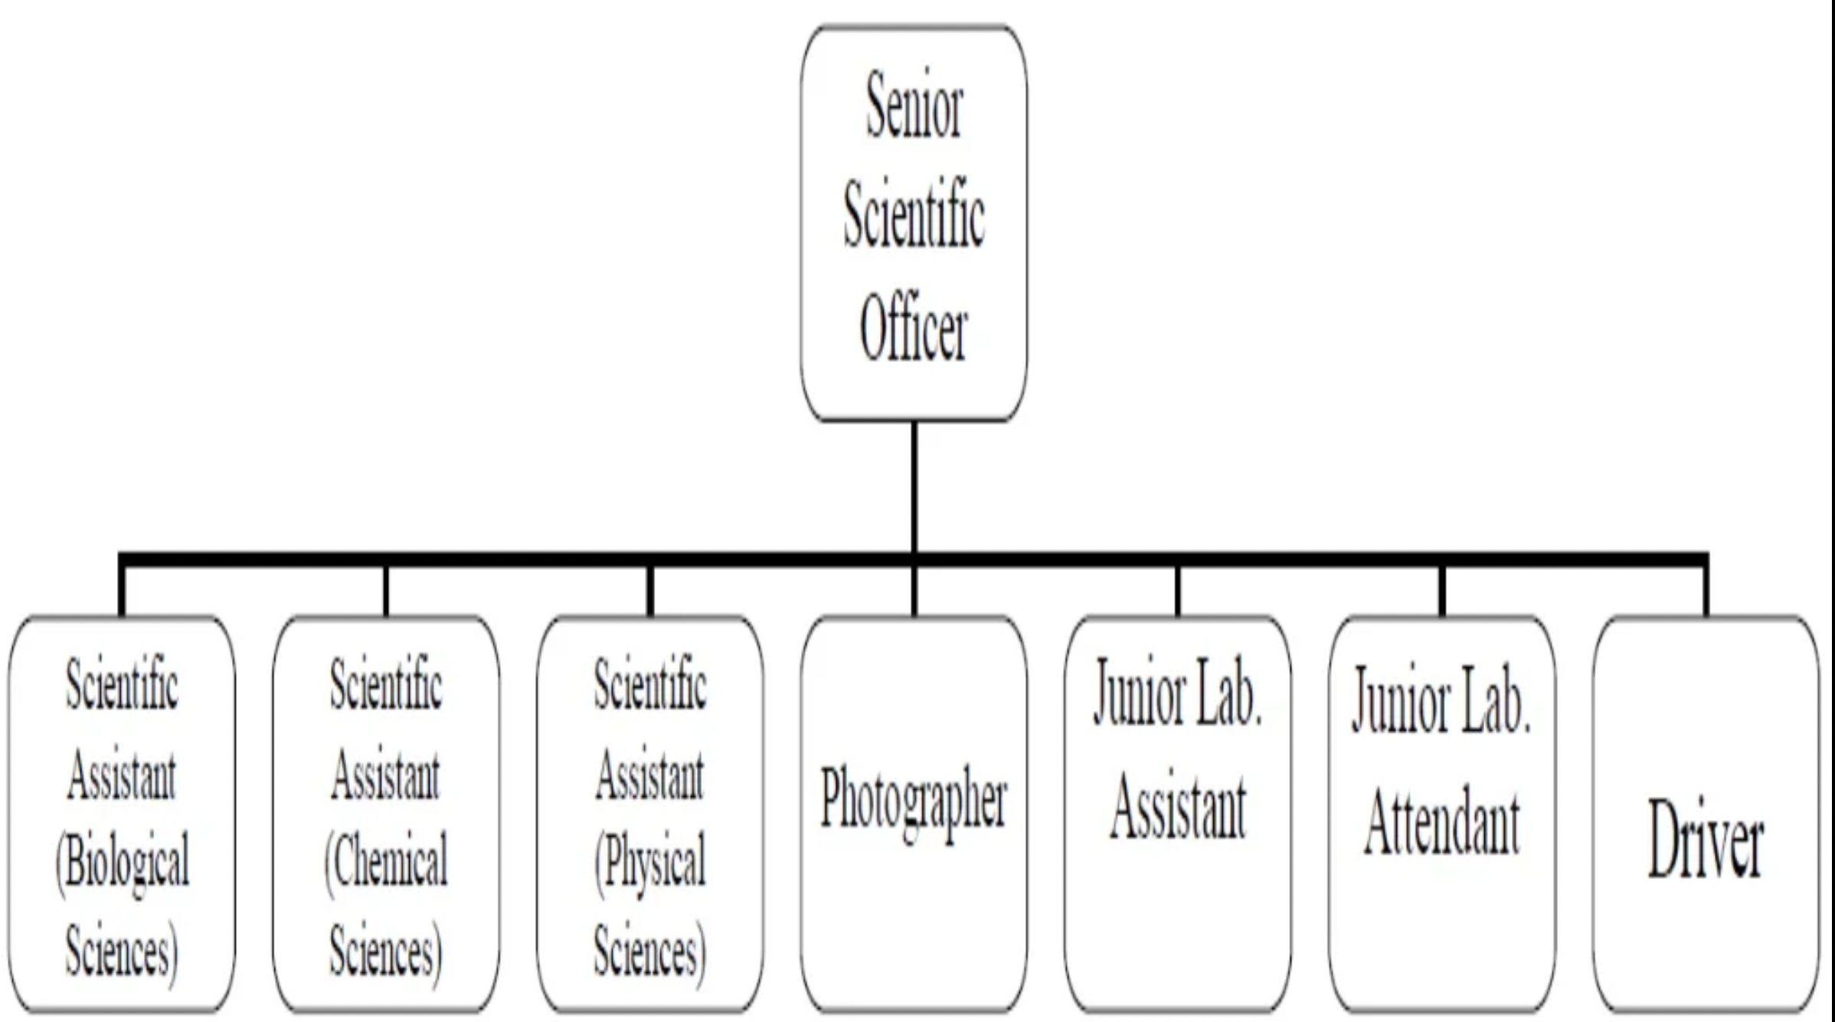
Organizational Structure of Mobile FSLs

Slide 20
Directorate of Investigating Agency and other Agencies involved in the Criminal Investigation:
Central Bureau of Investigation: Central Agency
Under the Ministry of Personnel, Public Grievances and Pensions, which is headed by a Cabinet Minister who directly reports to the Prime Minister, and it is located in New Delhi.
CBI was found in the year 1941 by the Government of India as the Special Police Establishment. During that time, its prime duties were to investigate corruption and bribery transactions that happened during World War II in the War and Supply Department of India.
The organization was founded by D. P. Kohli, who acted as the director of CBI the office from April 1st, 1963 to May 31st, 1968.
Subodh Kumar Jiswal- Current Director General of CBI.

Slide 21
Directorate of Investigating Agency and other Agencies involved in the Criminal Investigation:
Directorate of Enforcement- Economic Intelligence Agency
The CBI and ED usually work together for the investigation of crimes and money laundering cases respectively.
Therefore, the Central Bureau of Investigation (CBI) is the prime investigative police agency in India whereas the ED's (Enforcement Directorate) official website deliberates other objectives that are primarily linked to checking money laundering in India.
Enforcement Directorate is a law enforcement agency and an economic intelligence agency responsible for combating economic crimes and enforcement of economic laws. The Directorate of Enforcement headquartered at New Delhi is headed by the Director of Enforcement and there are five Regional offices located at Mumbai, Chennai, Chandigarh, Kolkata, and Delhi headed by Special Directors of Enforcement.
The Zonal Offices of the Directorate are located at Bangalore, Ahmedabad, Chandigarh, Chennai, Kochi, Delhi, Panaji, Jaipur, Guwahati, Hyderabad, Jalandhar, Kolkata, Lucknow, Mumbai, Patna, and Srinagar.

Slide 22
Directorate of Investigating Agency and other Agencies involved in the Criminal Investigation:
Narcotics Control Bureau- Anti- Drug Trafficking
NCB or Narcotics Control Bureau is an Indian Federal Law Enforcement that was established in 1986 whose agenda is to combat drug trafficking and the illegal use or abuse of substances under the Narcotics Drugs & Psychotropic Substances Act.
The Director-General of NCB is an officer of the Indian Police Service or the Indian Revenue Service.
It is engaged in team-work with the Customs and Central Excise/GST, State Police Department, Central Bureau of Investigation (CBI), Central Economic Intelligence Bureau (CEIB), and other Indian intelligence and law enforcement agencies.

